Slide 1
Social Enterprise
Just As Important as Fundraising
Allen Proctor -•- Sean McGee

Slide 2
What does social enterprise mean?
A business or line of business that:
Addresses a social problem
Uses entrepreneurial principles to organize, create, and manage a social venture for profit
Success defined by “Blended Return”: positive financial AND social benefit

Slide 3
Central Ohio Nonprofit Social Enterprises
Goodwill Stores
Zoombezi Bay water park
LSS: Freshbox Catering
LifeCare Alliance:LA Catering
Habitat for Humanity Re:Store

Slide 4
Why are profitable activities necessary?
Fundraising capacity is tapped out
More government and foundation grants are generating nonprofit losses

Slide 5
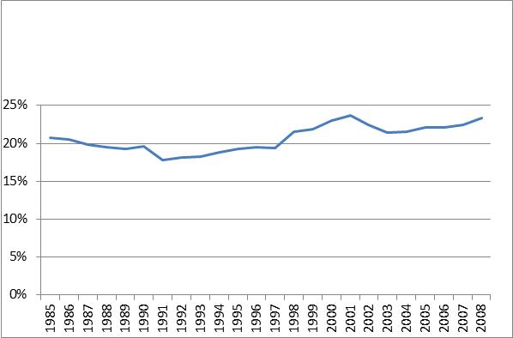
Philanthropy Is At Capacity
Contributions as Share of Total Nonprofit Revenue
US Totals

Slide 6
A Sustainable Nonprofit Business Model Requires Profitable Activities
Mission
Trauma center • • Orthopedic ward
Profitability
Do you have programs that are on the right hand side?

Slide 7
The Nonprofit Exists to Provide a Key Mission Activity:
Mission
Key Mission•
Profitability
loss
How do we close the gap?

Slide 8
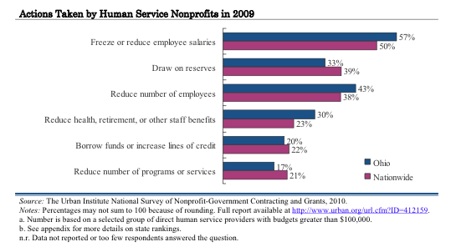
Alternative ways to close the mission gap are nearly tapped out
Cuts
Internally
Absorbed
By
Nonprofit
Providers
Service cuts avoided in 2009

Slide 9
Service reductions are becoming more necessary
Human services nonprofits were even more likely to take these steps.
Source: The State of the Ohio Nonprofit Sector, September 2012. Proctor’s Linking Mission to Money®

Slide 10
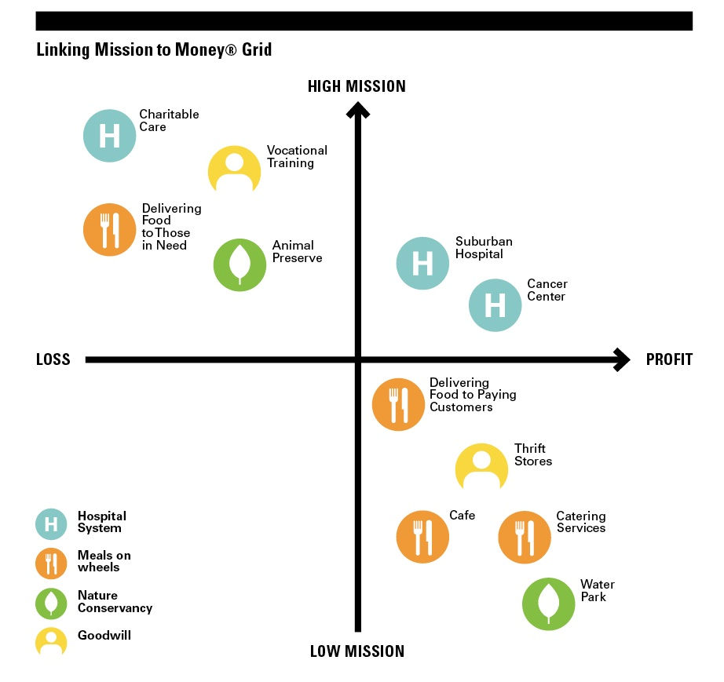
Social enterprise is now necessary: profitable activities supporting key mission activities

Slide 11
What do successful nonprofit social enterprises provide?
10
Revenue diversity needs to increase
Source: The State of the Ohio Nonprofit Sector, September 2012. Proctor’s Linking Mission to Money®

Slide 12
What does a successful social enterprise require?
11
More loan and investment capital needed
Source: The State of the Ohio Nonprofit Sector, September 2012. Proctor’s Linking Mission to Money®

Slide 13
CINCO Community Investment Network of Central Ohio
Working with you to develop your ideas into business plans
Some will be commercially viable.
CINCO seeks to invest in 3-5 new enterprises in 2014 and 2015

Slide 14
Working with CINCO
Open to all Central Ohio 501(c)(3) organizations
Intended for Executive Leadership
Multiple sessions of increasing intensity
Competitive process

Slide 15
Working with CINCO
Phase I – Getting Started
Self Assessment
Ideation
Vetting: Identify most promising idea(s)
Phase II – Gaining Focus
Development of most promising concept(s)
Feasibility
Phase III – Diving Deeper
In-Depth Business Planning
Pitching to Investors

Slide 16
Benefits of Working with CINCO
Develop new skills
Develop your team
Analysis and planning tools tailored to your organization
Rigorous process for evaluation of ideas
Advancement of earned income opportunities

